Slide 1

Rakshita Chadalawada
AP21110010297
SRM University AP

Slide 2
PROJECT TITLE/Problem Statement
Comprehensive Data Analytics of Vehicle Sales: Insights into Pricing, Depreciation, and Market Trends

Slide 3
AGENDA
Data Overview: Description of the dataset and key features and attributes.
Manufacturing Year Range: Range of manufacturing years for vehicles.
Vehicle Price Distribution: Lowest and highest vehicle prices.
Record Count and Data Quality: Total number of records and missing data analysis.
Key Insights: Most sold vehicle, presence of CNG vehicles, direct sales by individuals, automatic transmission vehicles, and single owner vehicles.
Depreciation Analysis: Most and least cost depreciated vehicles, brands less affected by cost depreciation.
Factors Affecting Depreciation: Correlation analysis and impact of vehicle age and distance driven on selling price.
Newest Vehicles: Analysis of vehicles manufactured post-2014.
Vehicle Type Analysis: Two wheelers—oldest, newest, most sold, and outliers.
Cars: Oldest, newest, and outliers.

Slide 4
PROJECT OVERVIEW
Analyze vehicle sales data to uncover trends and insights.
Examine the range of manufacturing years for vehicles and their price distribution.
Assess data quality, including the total number of records and missing values.
Highlight key findings such as the most sold vehicle, CNG vehicles, and direct sales by individuals.
Evaluate the prevalence of automatic transmission and single-owner vehicles.
Investigate depreciation patterns, including the most and least cost-depreciated vehicles.
Analyze brands less affected by depreciation and factors influencing depreciation.
Explore the impact of vehicle age and distance driven on selling price.
Examine vehicles manufactured after 2014 for new trends.
Detail insights into two-wheelers and cars, including the oldest, newest, most sold, and outliers.

Slide 5
WHO ARE THE END USERS of this project?
Automobile Dealerships: To understand market trends, pricing strategies, and vehicle popularity.
Car Manufacturers: For insights into vehicle performance and depreciation, aiding in product development and marketing strategies.
Insurance Companies: To adjust policies and premiums based on vehicle age, type, and depreciation.
Financial Analysts and Investors: For market forecasting and investment decisions related to the automotive sector.
Consumers: To make informed decisions about purchasing vehicles based on price, age, and other attributes.
Government Agencies: For data-driven policy making and regulation related to vehicle emissions and safety standards.
Research Institutions: To support studies on automotive trends, market dynamics, and technology adoption.

Slide 6
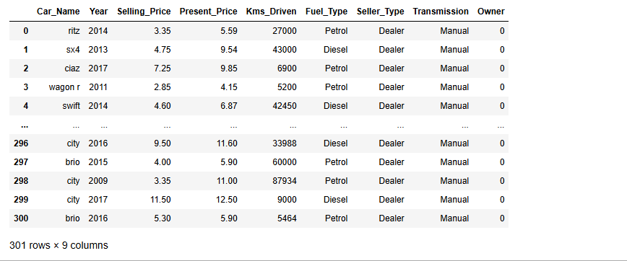
YOUR SOLUTION AND ITS VALUE PROPOSITION
Data set:cardekho

Slide 7
1)From which manufacturing year to which manufacturing year vehicles are present in this data ?
ans)the year range is from 2003 to 2018
2)What is the lowest price to which a vehicle is sold ?
ans)the lowest price to which a vehicle is sold is 0.1 lakhs
3)What is the highest price to which a vehicle is sold ?
ans)highest price to which a vehicle is sold 35.0 lakhs
4)How many records are there in this data ?
no.of records= 301
5)Are there any missing records in this data ?
since the sum of no.of null values are zero in each coloumn. there are no missing values
6)How many different vehicles are present in this data ?
98
7)Which is the most sold vehicle in this data ?
city 26
8)Does the database include any CNG vehicle ? If yes how many of them are there ?
so the data set has cng. and there are 2.

Slide 8
9)How many vehicles here are for sell from Individuals directly ?
106 vehicles here are for sell from Individuals directly
10)Does this database contain auto transmission vehicles ? If yes how many of them are there ?
40 are the number of auto transmission vehicals
11)How many single person owned vehicles are there in this database ?
10 single persons owned vehicles are there in this database
12)Which is the most and least cost depreciated vehicle in data ?
land cruiser is max ,Honda Activa 4G is min
13)Which brands of vehicles are less affected by cost depreciation ?
The brands of vehicles less affected by cost depreciation are:TVS Sport 0.040000Honda Activa 4G 0.045000Hero Passion X pro 0.050000Bajaj Avenger 150 0.050000 Honda Dream Yuga 0.060000
14)Are there any factors which you feel affect the cost depreciation ?
Year of manufacturing and kilometers driven

Slide 9
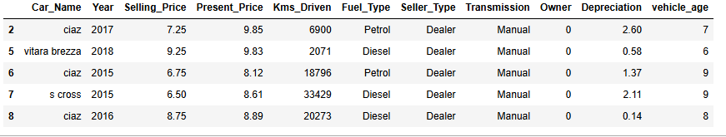
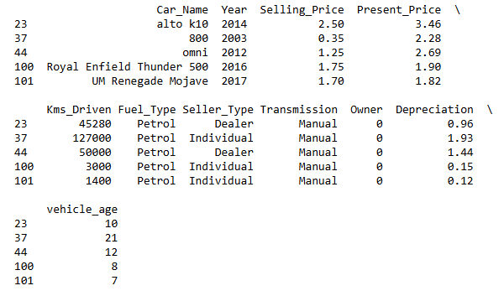
15)In general selling price is affected by age of vehicle and distance driven by vehicle , is it observable from data ?
yes
16)Can we get idea about newest vehicles i.e. after 2014 manufactured ?
Yes
17)Can we find out data of only two wheelers from this data ?Which is the oldest bike sold here?

Slide 10
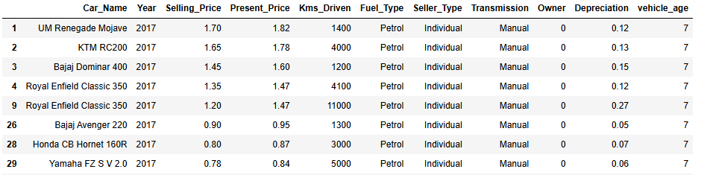
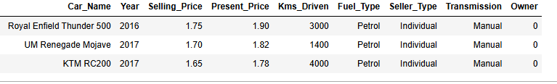
18)Which is the newest bike sold here?
19)Which is the most sold bike here?
Royal Enfield Classic 350 7
20)Do you find any deal in two wheelers which exceeded the general expectation ? Can you find reason for it ?

Slide 11
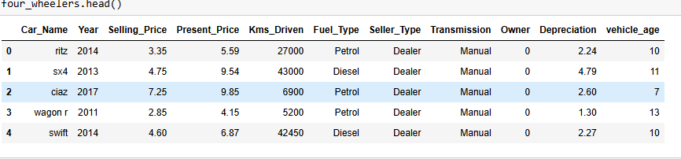
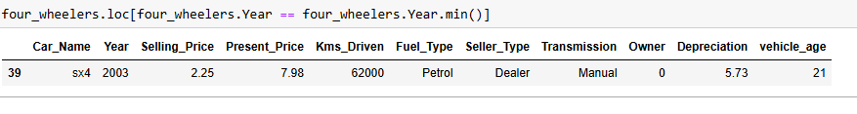
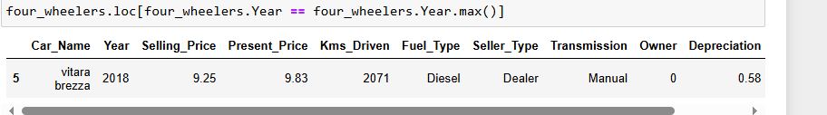
21)Can we find out data of only cars from this data ?
22)Which is the oldest car sold here?
23)Which is the newest car sold here?

Slide 12
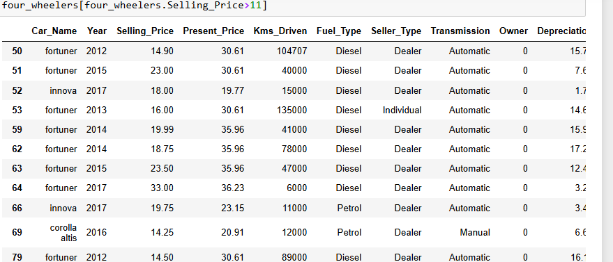
24)Do you find any deal in cars which exceeded the general expectation ? Can you find reason for it?

Slide 13
How did you customize the project and make it your own
i have analyzed a couple of questions which is not assigned to do.
1. Which vehicle brand has the highest average resale value?
This question aims to determine which brands retain their value the best over time.
ans)The vehicle brand with the highest average resale value is land cruiser with an average resale value of 35.0
2. What is the average mileage of vehicles based on fuel type (Petrol, Diesel, CNG, Electric)?
The average mileage of vehicles based on fuel type is:
Fuel_Type
CNG 42749.000000
Diesel 50369.916667
Petrol 33528.937238
Name: Kms_Driven, dtype: float64

Slide 14
MODELLING
I collected the dataset from Cardekho and loaded it into a pandas DataFrame.
I preprocessed the data, handling missing values and ensuring data consistency.
I analyzed the range of manufacturing years, identifying the earliest and latest years.
I identified the lowest and highest vehicle prices, providing insights into the price range.
I counted the total number of records and checked for any missing records.
I determined the number of different vehicles present, highlighting model variety.
I identified the most sold vehicle, revealing consumer preferences.
I counted the number of CNG vehicles, noting environmentally friendly options.
I analyzed vehicles sold directly by individuals, providing insights into the peer-to-peer market.
I counted vehicles with automatic transmission, indicating preference for automatic cars.

Slide 15
MODELLING
I identified the number of single-owner vehicles, providing ownership history insights.
I calculated the most and least cost depreciated vehicles and identified brands less affected by depreciation.
I analyzed factors affecting cost depreciation through correlation analysis.
I investigated the correlation between selling price, vehicle age, and distance driven.
I identified vehicles manufactured after 2014, highlighting newer models.
I analyzed two-wheelers, identifying the oldest, newest, most sold bikes, and deals exceeding price expectations.
I analyzed cars, identifying the oldest, newest cars, and deals exceeding price expectations.
I planned visualizations to represent my findings, making insights more accessible and understandable.

Slide 16
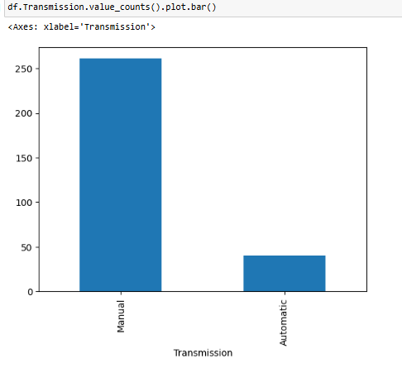
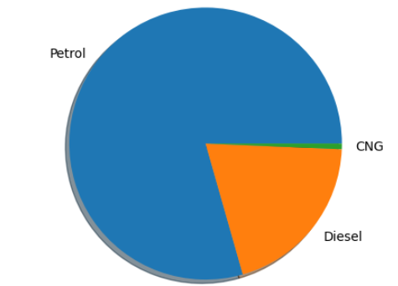
Results
pie chart showing proportion of petrol,diesel and CNG
showing transmission through manual is more than automatic.

Slide 17
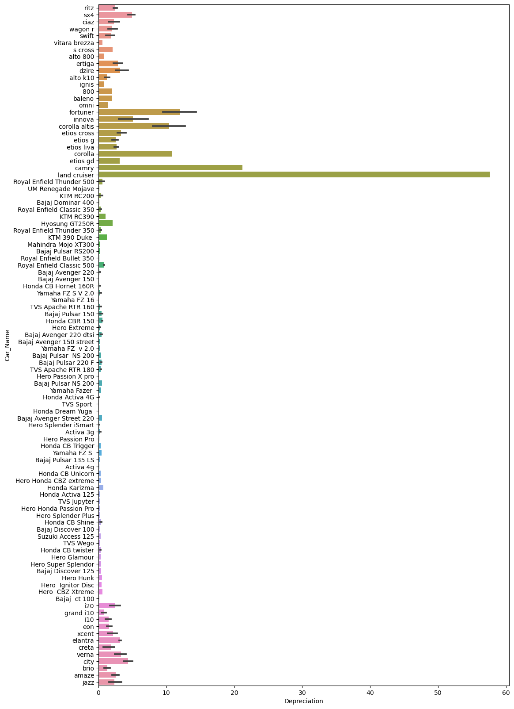
shows vehicals and cost depreciation

Slide 18
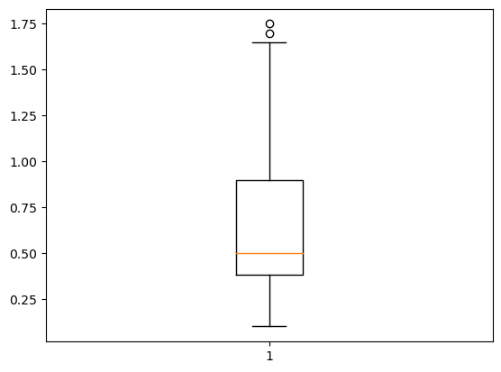
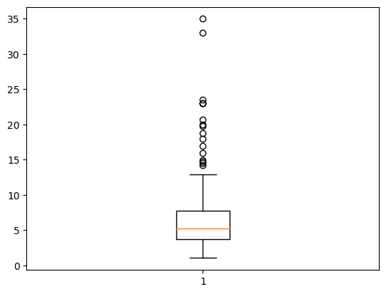
box plot showing outliers
in two wheelers
box plot showing outliers
in four wheelers

Slide 19
links

